Slide 2
Questionnaire Designing

Slide 3
Types of scales
Nominal scale
Gender
Marital status
Religion
Nationality
Ordinal Scale (

Slide 4
Types of scales
Ordinal scale
Performance ( Good , Very good, Excellent)
Happiness ( Happy, Very Happy, Extremely happy)

Slide 5
Types of scales
Interval scale
Interval scale has two features
Distance between options are same
And it does not have real zero i.e. absence of that property
Example : Temperature
0 degree Celsius means 32 Fahrenheit
0 Fahrenheit means -17 degree Celsius
Temperature
IQ

Slide 6
Types of scales
Ratio Scale
Weight
Height
Income

Slide 7
Types of Questions
Open ended
Closed ended
1.Dichotomous
2.MCQ
3.Scaled Questions

Slide 8
Open ended questions
What is the one thing you would like to see changed at the university? ___________________________________________
___________________________________________

Slide 9
Dichotomous questions
Have you ever smoked ?
[ ] Yes [ ] No
Gender
[ ] Male [ ] Female

Slide 10
Multiple choice questions
In which of the following categories does your age fall?
_______ Less than 18
_______ 18 to 30
_______ 31 to 45
_______ 46 to 60
_______ Over 60

Slide 11
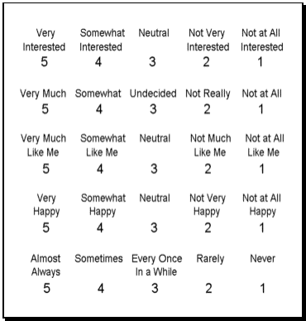
Scaled Questions -Likert scale

Slide 12
How to choose scale and question type
Information need
Output format & ease of tabulation & interpretation
Statistical analysis

Slide 13
Features of good questionnaire
Language
Difficulty level ( difficult words , jargons)
Stick to only necessary questions
Ease of recording
Sequence of the questions
Avoid biased questions
Avoid double barreled questions

Slide 14
Reliability and validity of questionnaire

Slide 15
Stages of good questionnaire
Stages of good questionnaire
List of information needed
Convert it into questions using proper scale
Arrange questions in to logical sequence
Pretest
Modification if needed
Make final draft of questionnaire

